Slide 1


Immigration & Refugee Crisis Name – Vansh student no. 301275893 Professor: MR. GOLam DASTAGIR

Slide 2
INTRODUCTION
We will be talking about people move to other countries, especially those running from danger.
We'll look at different views, how they're treated, and problems they face.

Slide 3

TERMS
Some terms
Immigration: Moving to live in a new country
Refugees: People running from danger in their own country
Asylum Seekers: People asking another country for protection from danger
We'll also show numbers of how many people are moving or escaping dangers

Slide 4

A Look Back
Let's see when and why big groups of people have had to leave their countries before
We'll also see how these patterns have changed over time

Slide 5


WHY THIS IS A SOCIAL ISSUE?
Impact on Communities: Immigration and refugee crises can affect the places where people are moving to. Sometimes, the sudden increase in population can create challenges like finding enough housing, jobs, schools, and healthcare for everyone. This can lead to tensions or conflicts in these communities.
Human Rights and Safety: Refugees often leave their homes in desperate situations. It's a social problem because it raises questions about human rights and compassion. We need to figure out how to help these people and ensure they're safe and treated fairly.
Cultural Differences: When people from different backgrounds come together, there might be differences in language, customs, and beliefs. While diversity is enriching, it can also create misunderstandings or prejudice if not managed well.

Slide 6
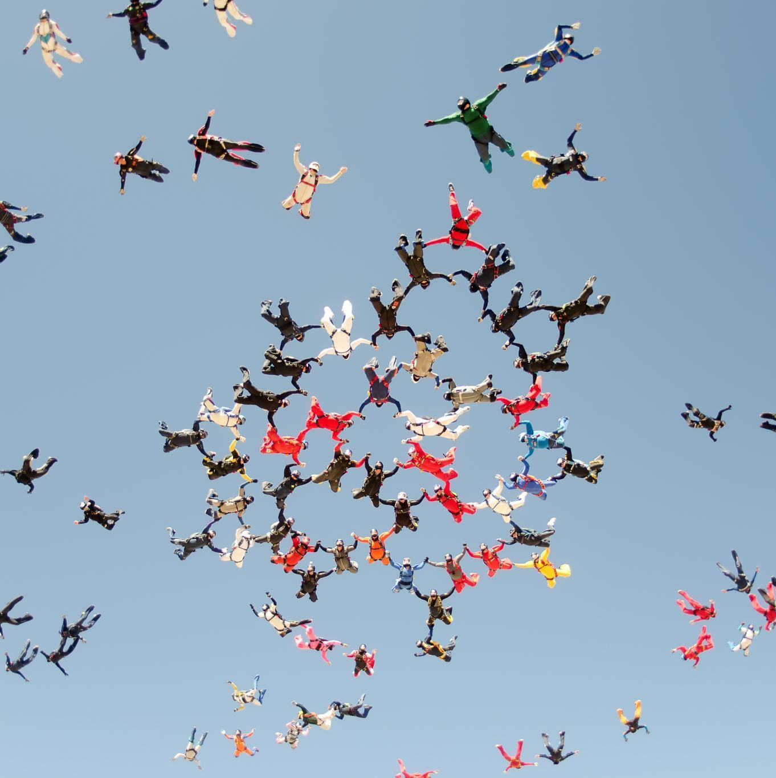
Why people Move?
Reasons people leave
Running from wars like in Syria
Trying to find better jobs or escape being really poor
Running from unfair treatment because of religion, race, or political beliefs
Running from things like floods or very dry periods

Slide 7

Debates on Immigration Policies
Border Control and Security: Debates on the strictness of border checks and the security risks of unchecked immigration.
Economic Implications: Discussion on immigrants taking jobs vs. contributing to the economy, including filling gaps in the job market. Cultural and Societal Integration: Concerns about integration and preserving German cultural identity.
Human Rights Perspective: Advocacy for the rights of immigrants and refugees to seek a safer, better life.

Slide 8
How We Treat Them
Some countries put these people in holding areas, there's a lot of talk about the conditions there
The journey to ask for protection is long and hard, with interviews and proving why they need help
In Germany, there are plans to help these people settle in
Some people welcome them, but others might act out of fear or misunderstanding

Slide 9

What's Tough for Them
Learning German is hard but there are classes
Finding a job can be tough especially if their skills aren't recognized, and they might face unfair treatment
Many face bad memories from wars or their journey, and need medical help
They also face legal issues, like whether they can stay or not

Slide 10
How Canada treats them
A migrant crisis is a situation in which large groups of immigrants flee their countries due to negative conditions and seek refuge in other countries¹.
A refugee crisis is a type of migrant crisis that involves people who have a well-founded fear of persecution and cannot return to their countries¹.
Canada is a global leader in protecting refugees and welcomed nearly half of all refugees resettled around the world in 2020².
Canada’s refugee system works by providing protection, resettlement and integration services to refugees who meet the eligibility criteria³.
Canada also faces challenges and pressures from multiple refugee crises across the globe, such as the situations in Afghanistan, Myanmar, Syria and Venezuela

Slide 11

Germany's Story
In 2015, a LOT of people came to Germany
At first, Germany welcomed everyone, but then put some limits because of various pressures
Germany tried to help with language classes, job training, and helping them understand the culture
People in Germany have strong feelings, some very welcoming, but others against these newcomers

Slide 12
World's Take
Germany gives a lot to help refugees globally
Germany promises to protect refugees as per a 1951 agreement
In Europe, Germany is pushing for shared solutions and responsibilities

Slide 13
What We Recommend
Countries should work together to tackle why people leave in the first place
Plans should be there to help newcomers learn the language and culture
Make it easier for them to get jobs
Communities should welcome them and we should clear up wrong ideas about these newcomers

Slide 14
CHATGPT RESEARCH ON THIS TOPIC
Root Causes: Conflicts, persecution, poverty, and climate change drive displacement.
Economic Impact: Immigrants often contribute positively to host economies but can strain resources if integration isn't managed.
Mental Health: Refugees face trauma, affecting their long-term well-being.
Assimilation Challenges: Language barriers, cultural differences, and discrimination can hinder integration.
Legal Complexities: Differing asylum laws and policies impact refugee acceptance rates.
Human Trafficking: Crises increase vulnerability to exploitation.
Demographic Shifts: Aging populations in many Western countries can benefit from younger immigrants.
Policy Debates: Balancing humanitarian, security, and economic concerns is challenging.
Camps vs. Integration: Prolonged camp stays can hinder self-sufficiency.
Global Disparities: Most refugees are hosted by developing countries, often neighbors to the conflict zones.

Slide 15
Critique on chatgpt
Generalization: "Conflicts" is broad; needs specificity.
Economic Impact: Lacks nuance; benefits vary by factors.
Mental Health: No mention of limited resources for refugees.
Assimilation Challenges: Overly simplistic; resources and experiences vary.
Legal Complexities: Needs depth on controversies like "safe third country" rules.
Human Trafficking: Requires more context or examples.
Demographic Shifts: Risks viewing immigration as only a demographic solution.
Policy Debates: Vague; needs clarity on concerns.
Camps vs. Integration: Dichotomy might be oversimplified.
Global Disparities: Omitting strain on developing countries' infrastructure.

